Slide 1
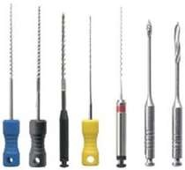
INSTRUMENTS , MATERIALS & DEVICES

Slide 2
Advances in science & research in endodontics has lead to change in the design of endodontic instruments , materials and techniques
All these changes are focused on improved instrumentation technique in minimum time with less fatigue to the patient & the operator

Slide 3
CLASSIFICATION OF INSTRUMENTS

Slide 4
Classification According to Function (Grossman’s Classification)
FUNCTION | INSTRUMENTS
Exploring | Smooth broaches and endodontic explorers (Used to locate canal orifice and to determine the direction and patency of root canal
Debriding or extirpating | Barbed broaches (Used to extirpate the pulp and to remove debris and other foreign materials
Cleaning&Shaping | Reamers and Files (Used to shape the canal space laterally and apically )
Obturating | Pluggers, spreaders and lentulospirals (To cement and pack guttapercha points into the canal space)

Slide 5
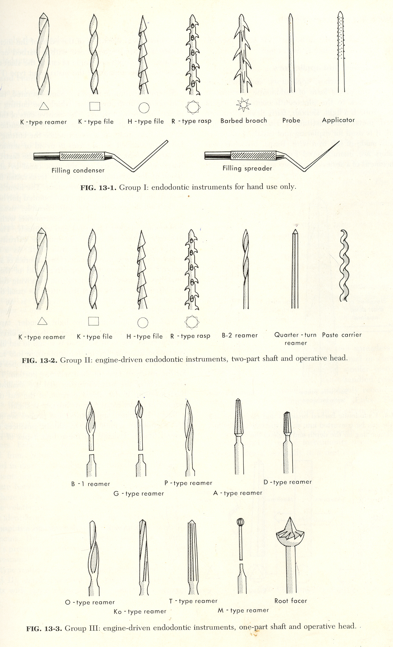
ISO AND FDI CLASSFICATION OF ENDODONTIC INSTRUMENTS 1973
GROUP | TYPES OF INSTRUMENTS – HAND / ENGINE DRIVEN | EXAMPLES
I | Hand use only | Files : K-type, H type Reamers:K & U-type Broaches Pluggers & Spreaders

Slide 6
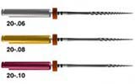
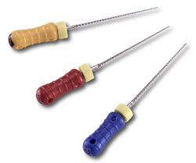
groups | TYPES OF INSTRUMENTS – HAND / ENGINE DRIVEN | EXAMPLES
II | Engine driven latch type Handle has been replaced by a latch type adaptor for insertion in contra angle hand piece 2 parts - cutting head & latch type attachment | Similar to group I instruments also includes paste fillers (lentulo spirals)
K- reamer
Lentulo spiral
Greater Taper Ni-Ti instruments
GROUP I

Slide 7
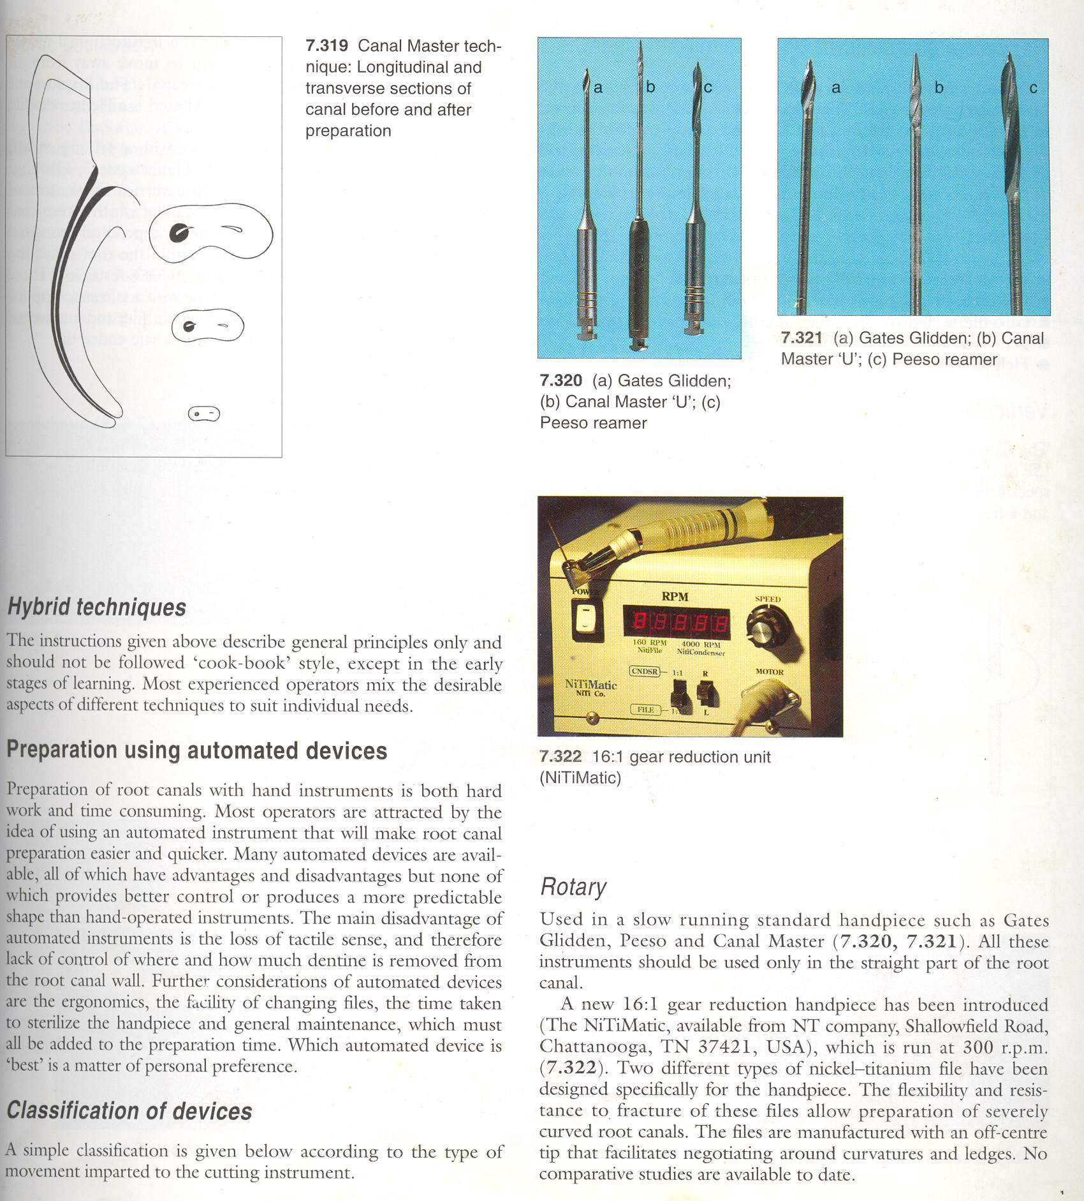
group | TYPES OF INSTRUMENTS – HAND / ENGINE DRIVEN | EXAMPLES
III | engine driven latch type drills or reamers fabricated from a single metal latch and shaft and operative head, all compound of a single piece | Gates − Glidden Peeso reamers Kurer root facer
Gates- Glidden drills
Peeso reamers

Slide 8
group | TYPES OF INSTRUMENTS – HAND / ENGINE DRIVEN | EXAMPLES
IV | Root canal points | Gutta percha points Silver points Paper points

Slide 9
Classification of automated devices (Christopher Stock 1995)based on type of movt imparted to cutting instr
1 | Rotary | Gates glidden,peaso,canal master,16:1 gear reduction handpiece:NiTiMatic
2 | Reciprocal(1/4 turn) | Giromatic1964 ,endocursor
3 | vertical | Canal findersystem,canal leader
4 | Random | Excalibur- runs at 20000-25000 rpm
5 | Sonic oscillation | Sonic air 1500 & megasonic1400(micromega) Endostar
6 | Ultrasonic oscillation | Caviendo-magnetostrictive Piezon master400-piezoelectric

Slide 10
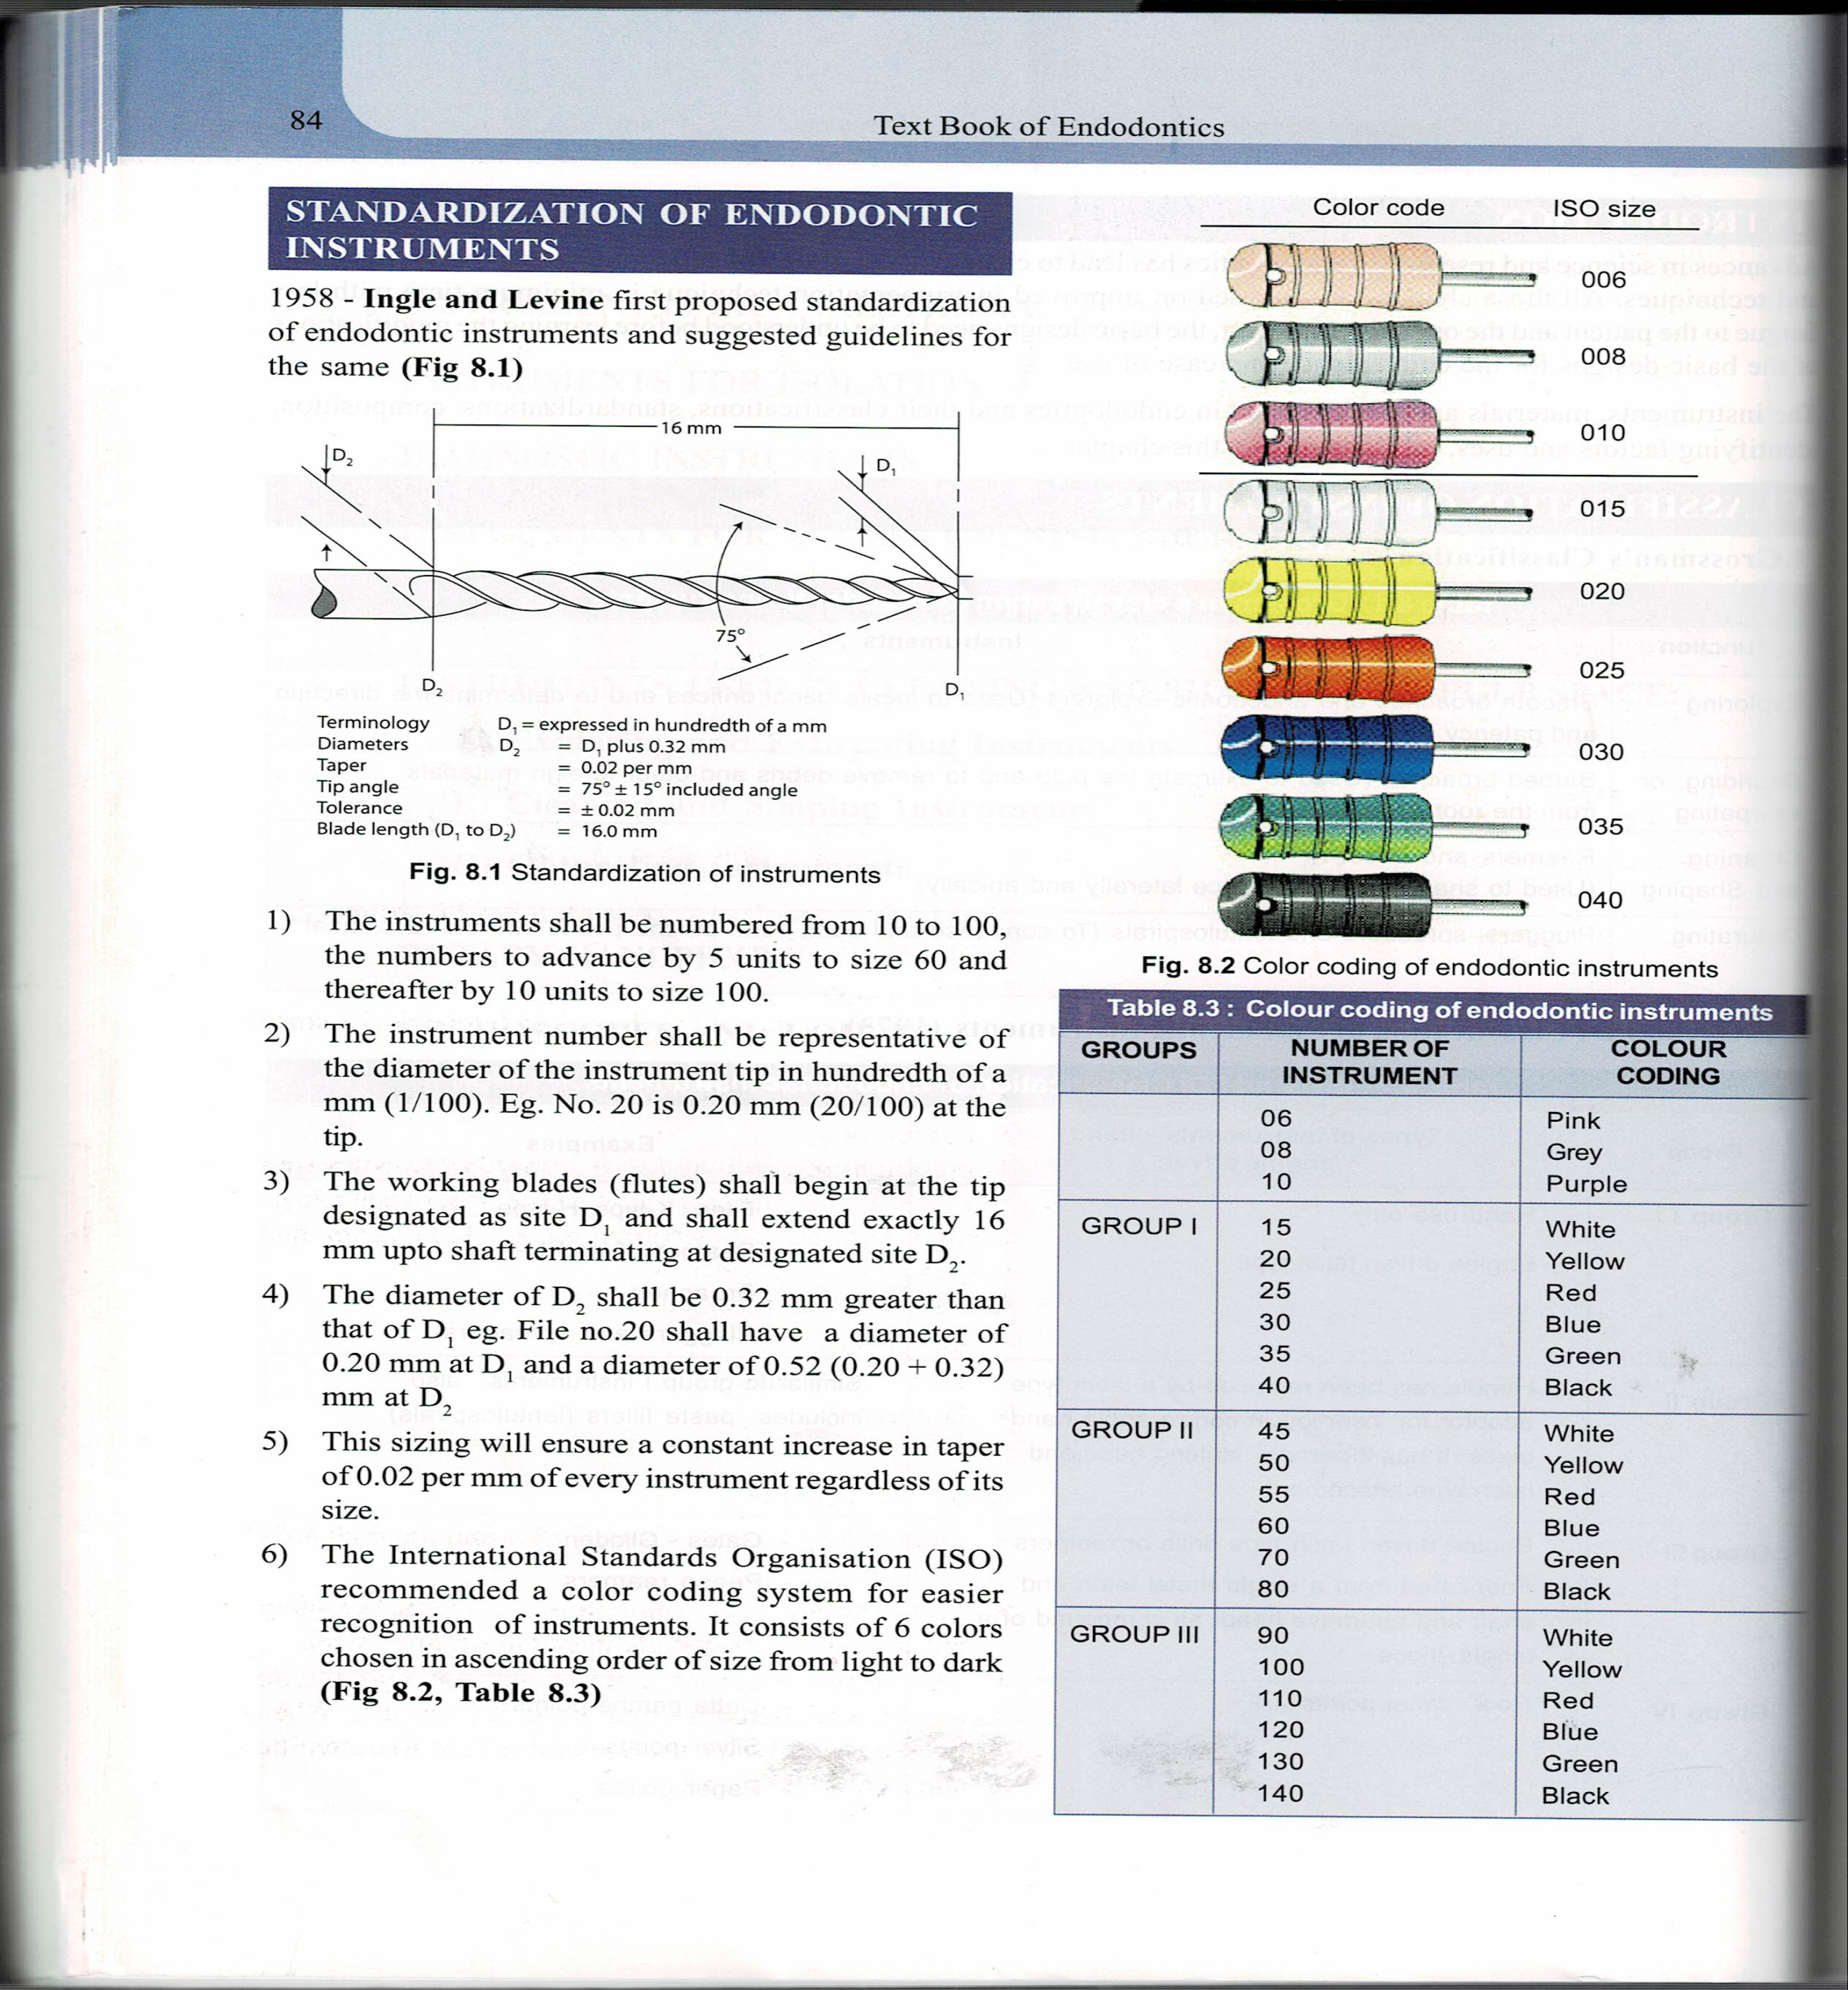

STANDARDIZATION OF ENDODONTIC INSTRUMENTS
1st – 1958 – ingle & levine – proposed standardization of endodontic instruments

Slide 11


The international standards organization (ISO)reccommended a color coding system for easier recognition of instruments .
It consists of 6 colors chosen in ascending order of size from light to dark

Slide 12
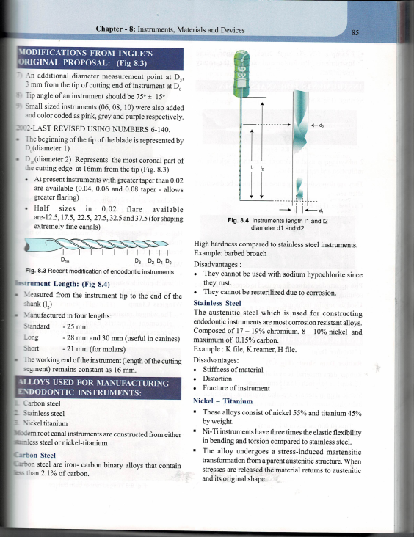
Modifications from Ingle’s original proposal
An additional diameter measurement point at D3, 3mm from the tip of cutting end of instrument at D0
Tip angle – should be 75 degree +/- 15 degree
Small sized instruments (06, 08,10) – were added & color coded as pink , grey & purple
2002 – LAST REVISED USING NUMBERS 6-140
Beginning of the tip of the blade is represented by D0 (diameter 1)
D16 represents the most coronal part of the cutting edge at 16mm from the tip
At present instruments with greater taper than 0.02are available (0.04, 0.06 & 0.08 taper – allows for greater flaring
Half sizes in 0.02 flare available are – 12.5, 17.5 , 22.5 , 27.5 , 32.5 , & 37.5 ( for shaping extremely fine canals )

Slide 13
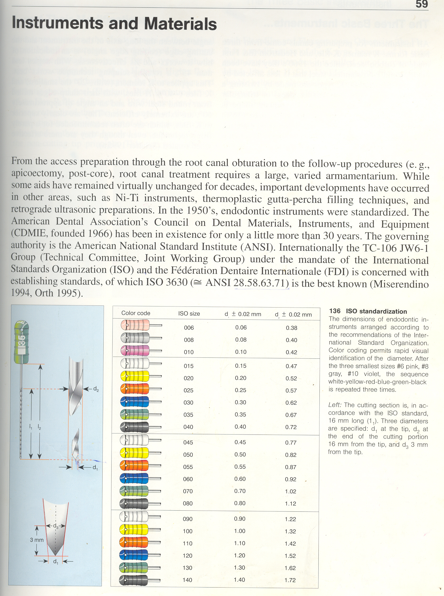
Instrument length:
Measured from the instrument tip to the end of the shank (l₂)
Manufactured in four lengths
  Standard − 25 mm
  Long − 28 mm and 30 mm (useful in canines)
  Short − 21 mm (used in 2nd and 3rd molars or when patient has restricted mouth opening)
The working end of the instrument (length of the cutting segment, l₁ ) remains constant is 16 mm.

Slide 14
Alloys used for manufacturing endodontic instruments
Carbon steel
Stainless steel
Nickel titanium
Modern root canal instruments are constructed from either stainless steel / nickel titanium

Slide 15
CARBON STEEL
In 19th century carbon steel was used for manufacturing of instruments.
Iron –carbon binary alloys that contain less than 2.1% of carbon
High hardness
Disadvantages
Fracture tendency due to the brittleness of metal.
Cannot be used with sodium hypo chlorite – rust
Cannot be resterilized – corrosion

Slide 16
STAINLESS STEEL
In 20th century stainless steel was used by Kerr
Corrosive resistant alloys
Composed – 17-19% Chromium ,8-10% Nickel , Carbon – 0.15%
Example – K file, K reamer , H file
DISADVANTAGES
Stiffness of material
Distortion
Fracture of instrument

Slide 17
NICKEL –TITANIUM
Consist of nickel 55% , titanium 45% by wt
ADVANTAGES
Low elastic modulus - elastic flexibility to instrument ,hence used in curved canal
Shape memory alloy ---it has the ability to recover from plastic strain when unloaded.
DISADVANTAGE
Expensive

Slide 18
INSTRUMENTS USED FOR INITIAL EXAMINATION

Slide 19
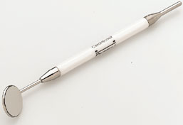
INSTRUMENTS USED FOR INITIAL EXAMINATION
Rear surface
Front surface
MOUTH MIRROR
Two types
REAR SURFACE - Aluminium coated under vacuum on the reverse side of the glass to eliminate scratch damage
FRONT SURFACE -Will not give a double image, they are ideal for endodontic procedures

Slide 20
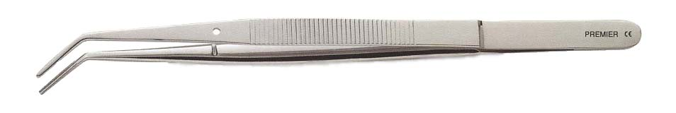
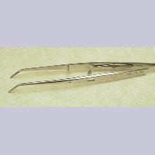
ENDODONTIC PLIERS
Working part has grooves
For holding gutta percha & absorbent points
Locking
Non-locking
Available
For secure transfer of points

Slide 21
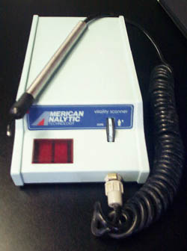
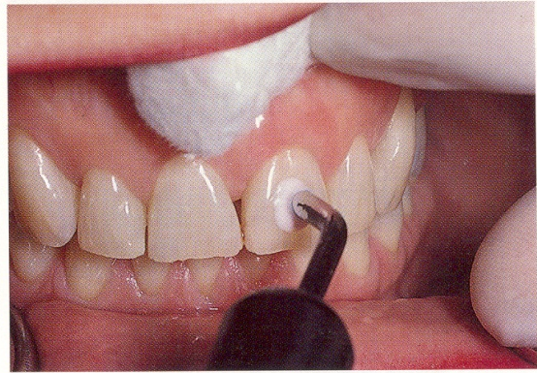
ELECTRIC PULP TESTER
Evaluates the condition of the pulp , based on the electrical excitation of neural elements within the pulp .
A positive response – Vitality of pulp
No response- Pulp necrosis / Nonvital pulp

Slide 22
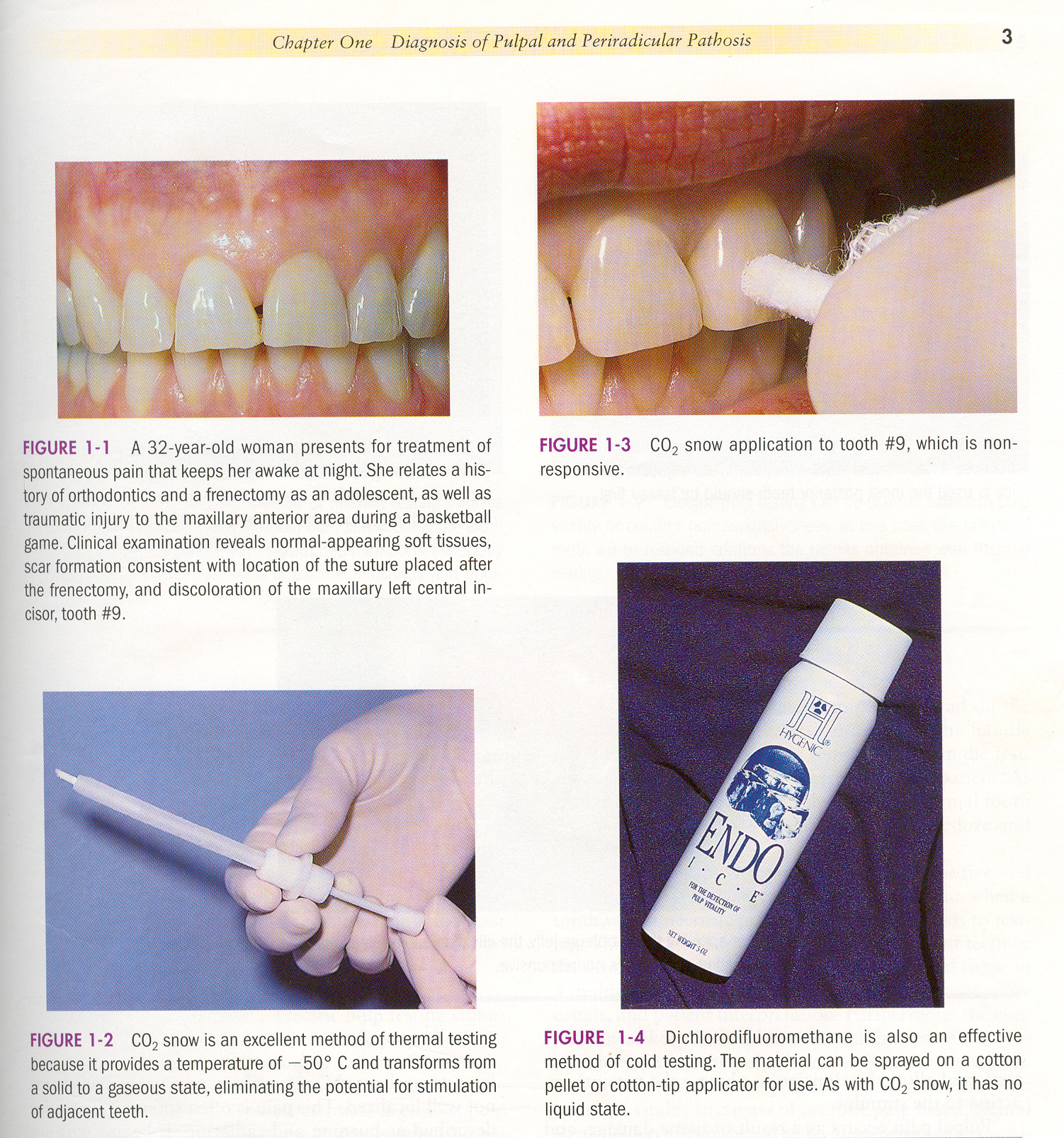
ENDO –ICE - DICHLORODIFLUOROMETHANE
Sprayed on a cotton pellet / cotton tip applicator – checking vitality of the tooth
Colder than ice / ethyl chloride – 26.2 degree centigrade

Slide 23
INSTRUMENTS USED FOR ACCESS CAVITY PREPARATION

Slide 24
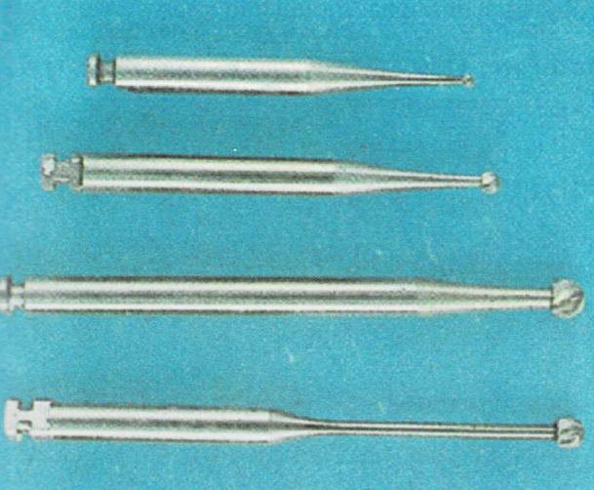
ACCESS OPENING BURS
Small standard round bur
16mm bur shank , 3mm longer than standard bur
Long shank round bur (23mm)
Goose neck round bur

Slide 25

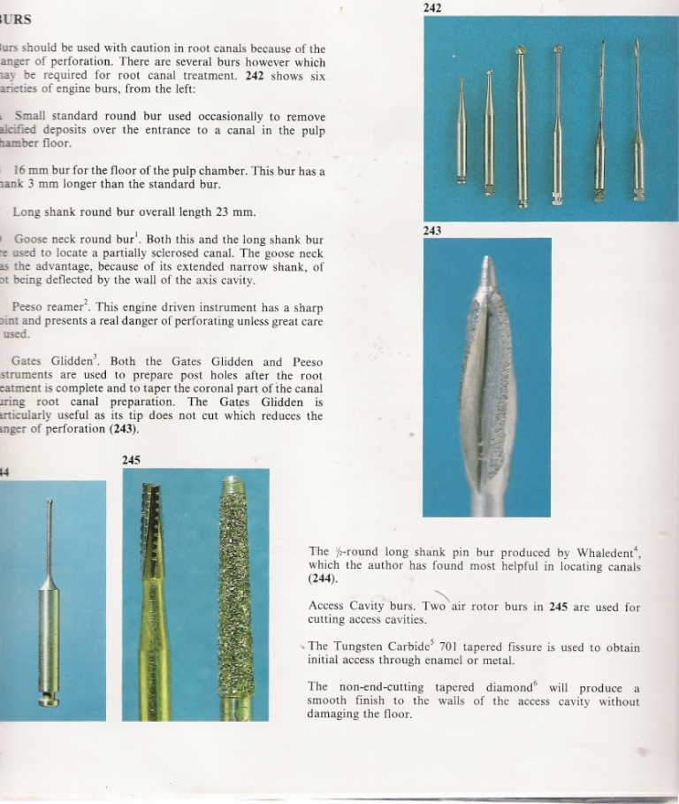
ACCESS REFINING BURS
Coarse grit flame shaped diamond
Tapered round- end diamonds
PENETRATORS & METAL CUTTERS
Full non precious metal casting & non precious substructures of PFM crowns
Round end cross cut design that minimizes chatter

Slide 26
MULLER BUR
Long shaft , round carbide – tipped burs – low speed hand piece
ADVANTAGES
Long shaft – useful for working deep in the radicular portion
Increases visibility of the cutting tip
Muller bur & microscopes make treatment of calcified canals less stressful & more predictable
DISADVANTAGES
Made of carbide – donot endure sterilization – becomes dull quickly

Slide 27
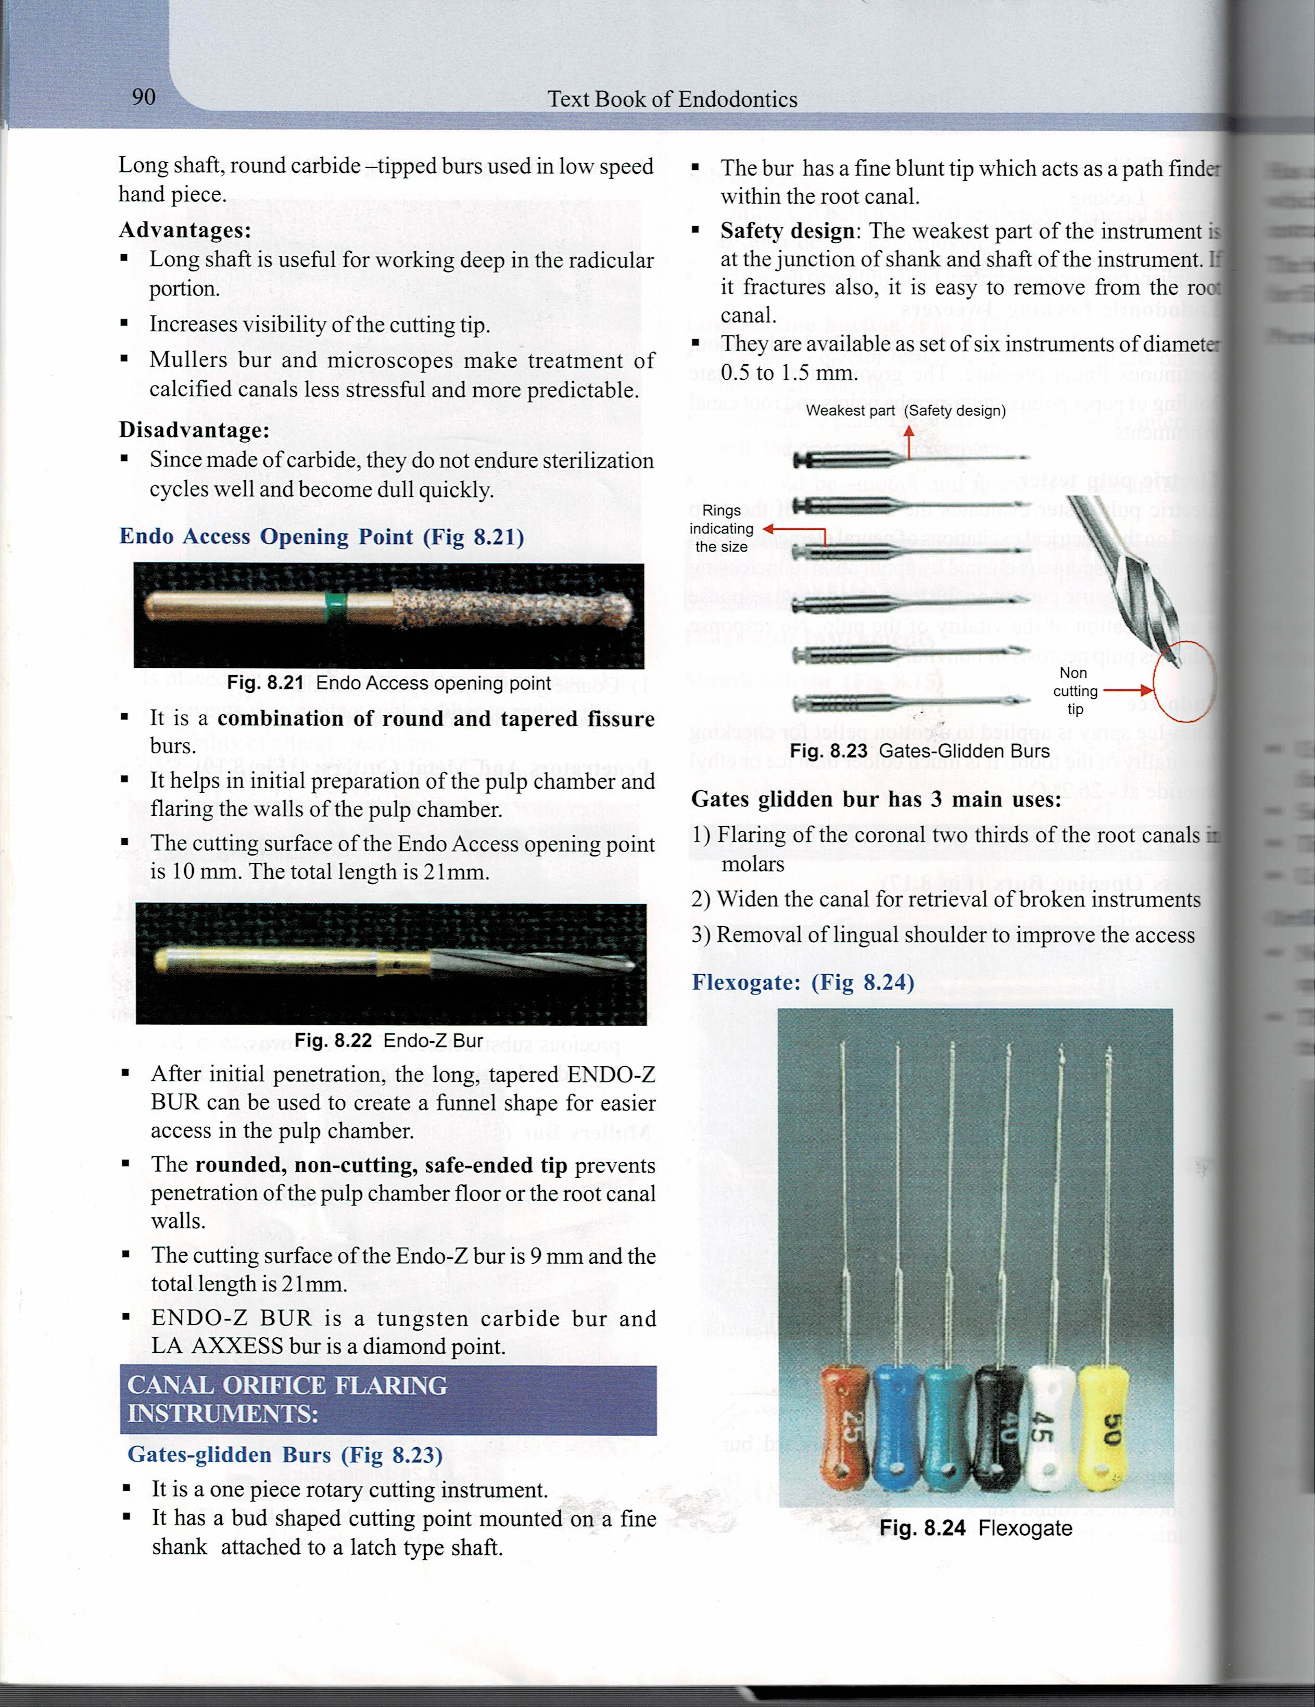
ENDO ACCESS OPENING POINT
Combination of round & tapered fissure burs
Initial preparation of pulp chamber & flaring the walls of the pulp chamber
The cutting surface is 10mm – total length is 21mm

Slide 28
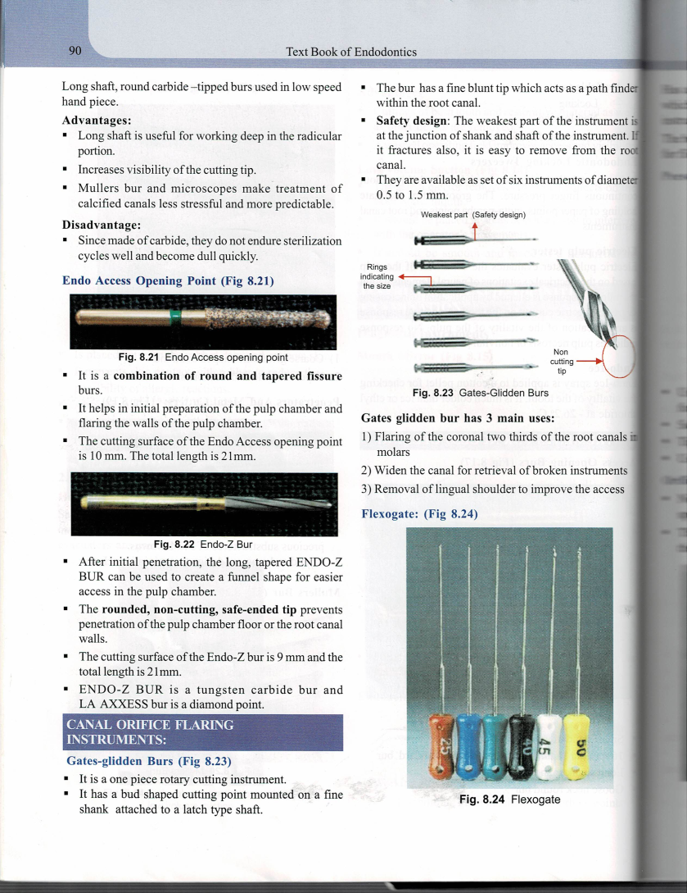
Endo –Z bur
After initial penetration – tapered ENDO-Z BUR – used – create a funnel shape – easier access in the pulp chamber
Rounded , no cutting , safe –ended tip- prevents penetration of the pulp chamber floor / the root canal walls
Endo-z bur -9mm & total length -12mm-Tungsten carbide bur
LA AXXESS bur –diamond point

Slide 29
CANAL ORIFICE FLARING INSTRUMENTS

Slide 30
GATES –GLIDDEN BURS
Bud shaped cutting point mounted on a fine shank attached to a latch type shaft
Fine blunt tip – acts as a path finder within the canal
SAFETY DESIGN- the weakest part of the instrument – is at the junction of shank & shaft of the instrument , if fractures – easy to remove from the root canal
Available as set of 6 instruments of diameter 0.5to 1.5mm
3 main uses
Flaring of the coronal 2/3rd – molars
Widen the canal- retrieval of broken instruments
Removal of lingual shoulder to improve access

Slide 31
FLEXOGATE
Non cutting guiding tip & debris evacuation zone – helps to maintain root canal configuration during instrumentation

Slide 32
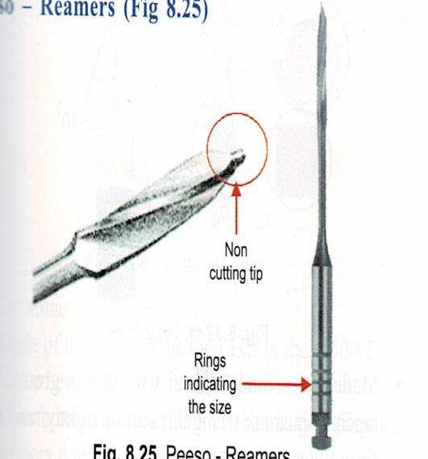
Peeso – Reamers
Used – preparation of post space – root canal – receiving a post endo restoration
Safe – ended
Tip – diameter – 0.7- 1.7mm
Used in brushing motion

Slide 33

ORIFICE SHAPERS
Nickel titanium designed – used – controlled , slow speed , high torque , rotary hand piece
Designed to provide a continuous shape in the coronal 2/3rd of root canal
GOLDEN MEDIUM
Aids in location of curved canals
Numbered – 12,17,22,27,32,37 –roughly corresponds in size to half way between standard ISO sizes

Slide 34
Instruments used in cleaning & shaping the pulp space

Slide 35

A. EXPLORING & EXTIRPATING INSTRUMENTS
Endodontic explorer –DG16 (Hu Friedy)
Double ended instrument , long tapered tines either at right / obtuse angle
Stiff – used –locate & probe the orifice of the root canal
Used – explore regions of the pulpal floor & calcified dentin

Slide 36
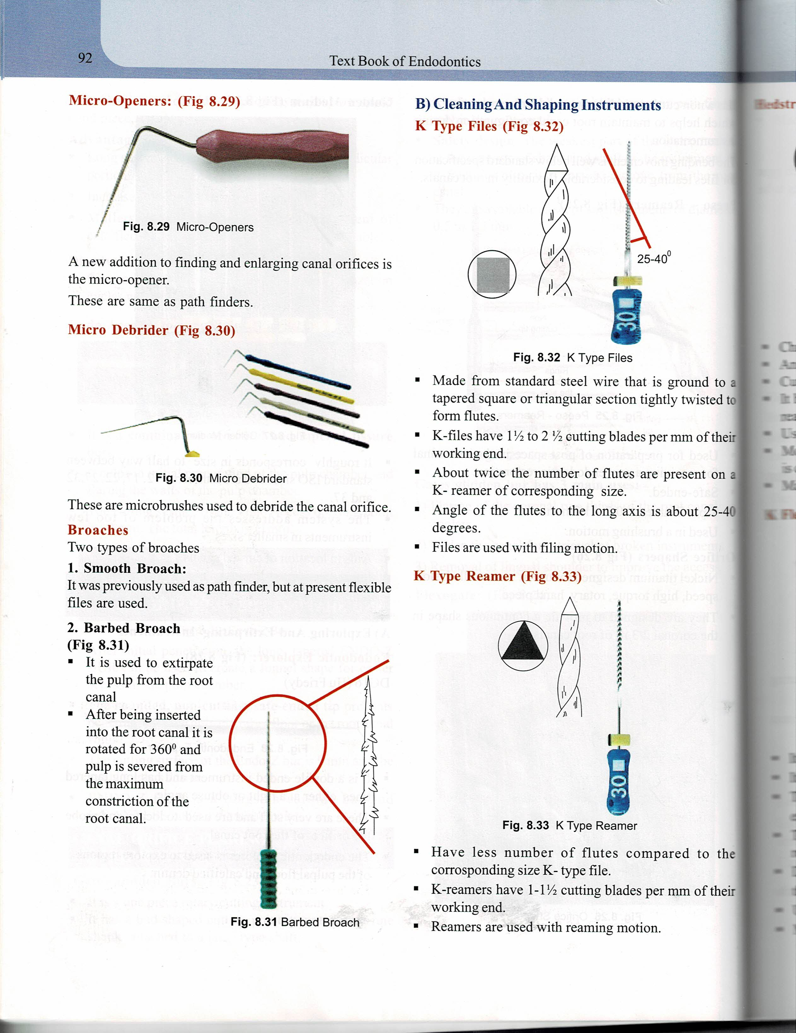
MICRO -OPENERS
Finding & enlarging canal orifices
Same as path finders
MICRO DEDRIDERS
Micro brushes used to debride the canal orifice

Slide 37

BROACHES
Smooth broach
Barbed broach
2 types
Previously – used as path finder , presently –flexible files are used
Used- extirpate the pulp from the root canal
After – inserted into the root canal – it is rotated for 360 degree & pulp is served from the maximum constriction of the root canal

Slide 38
FUNCTIONS
Used to remove the intact pulp
‘Barbs’ on the broach snag the pulp to facilitate removal
Retrieve a paper point or cotton pellet trapped in the canal
Loosen debris in necrotic canal..

Slide 39

B. CLEANING & SHAPING INSTRUMENTS
K Type files
Made – standard steel wire – ground to a tapered square / triangular section tightly twisted to form flutes
K- files have 1 ½ to 2 ½ cutting blades per mm of their working length
Angle of the flutes to the long axis – 25 -40 degrees
Used – filing motion

Slide 40
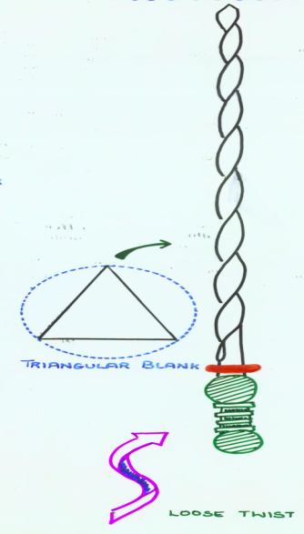
K type reamer
Have less number of flutes compared to the corresponding size K – type file
Have 1-1 ½ cutting blades per mm of their working length
Used - reaming motion

Slide 41
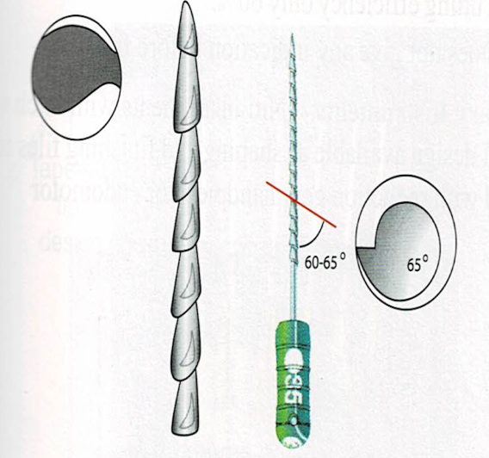
HEDSTROM FILES
Christmas tree appearance
Angle of the flutes to the long axis – 60-65 degree
Cuts when pulled / rotated clockwise
Better cutting efficiency than k- type files & reamers due to more positive rake angle
Used – lateral scraping motion
Susceptible to fracture & hence filing motion- contraindicated
Made of stainless steel

Slide 42

K FLEX FILES
Modified K –File
Rhomboid in cross section
2 acute angles with increased sharpness & cutting efficiency
2obtuse angles provide more areas for debris removal
Decreased contact with the canal walls further reduces the danger of compacting dentinal fillings in the canal
Used – filing & rasping motion
Made- NiTi – flexible

Slide 43
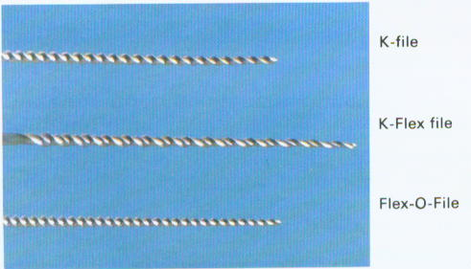
Flex o file
Triangular cross- section that gives sharper cutting blades & more room for debris removal
Extremely flexible & resists facture
Made of NiTI & hence flexible
The file tip is non cutting ( Butt tip )

Slide 44
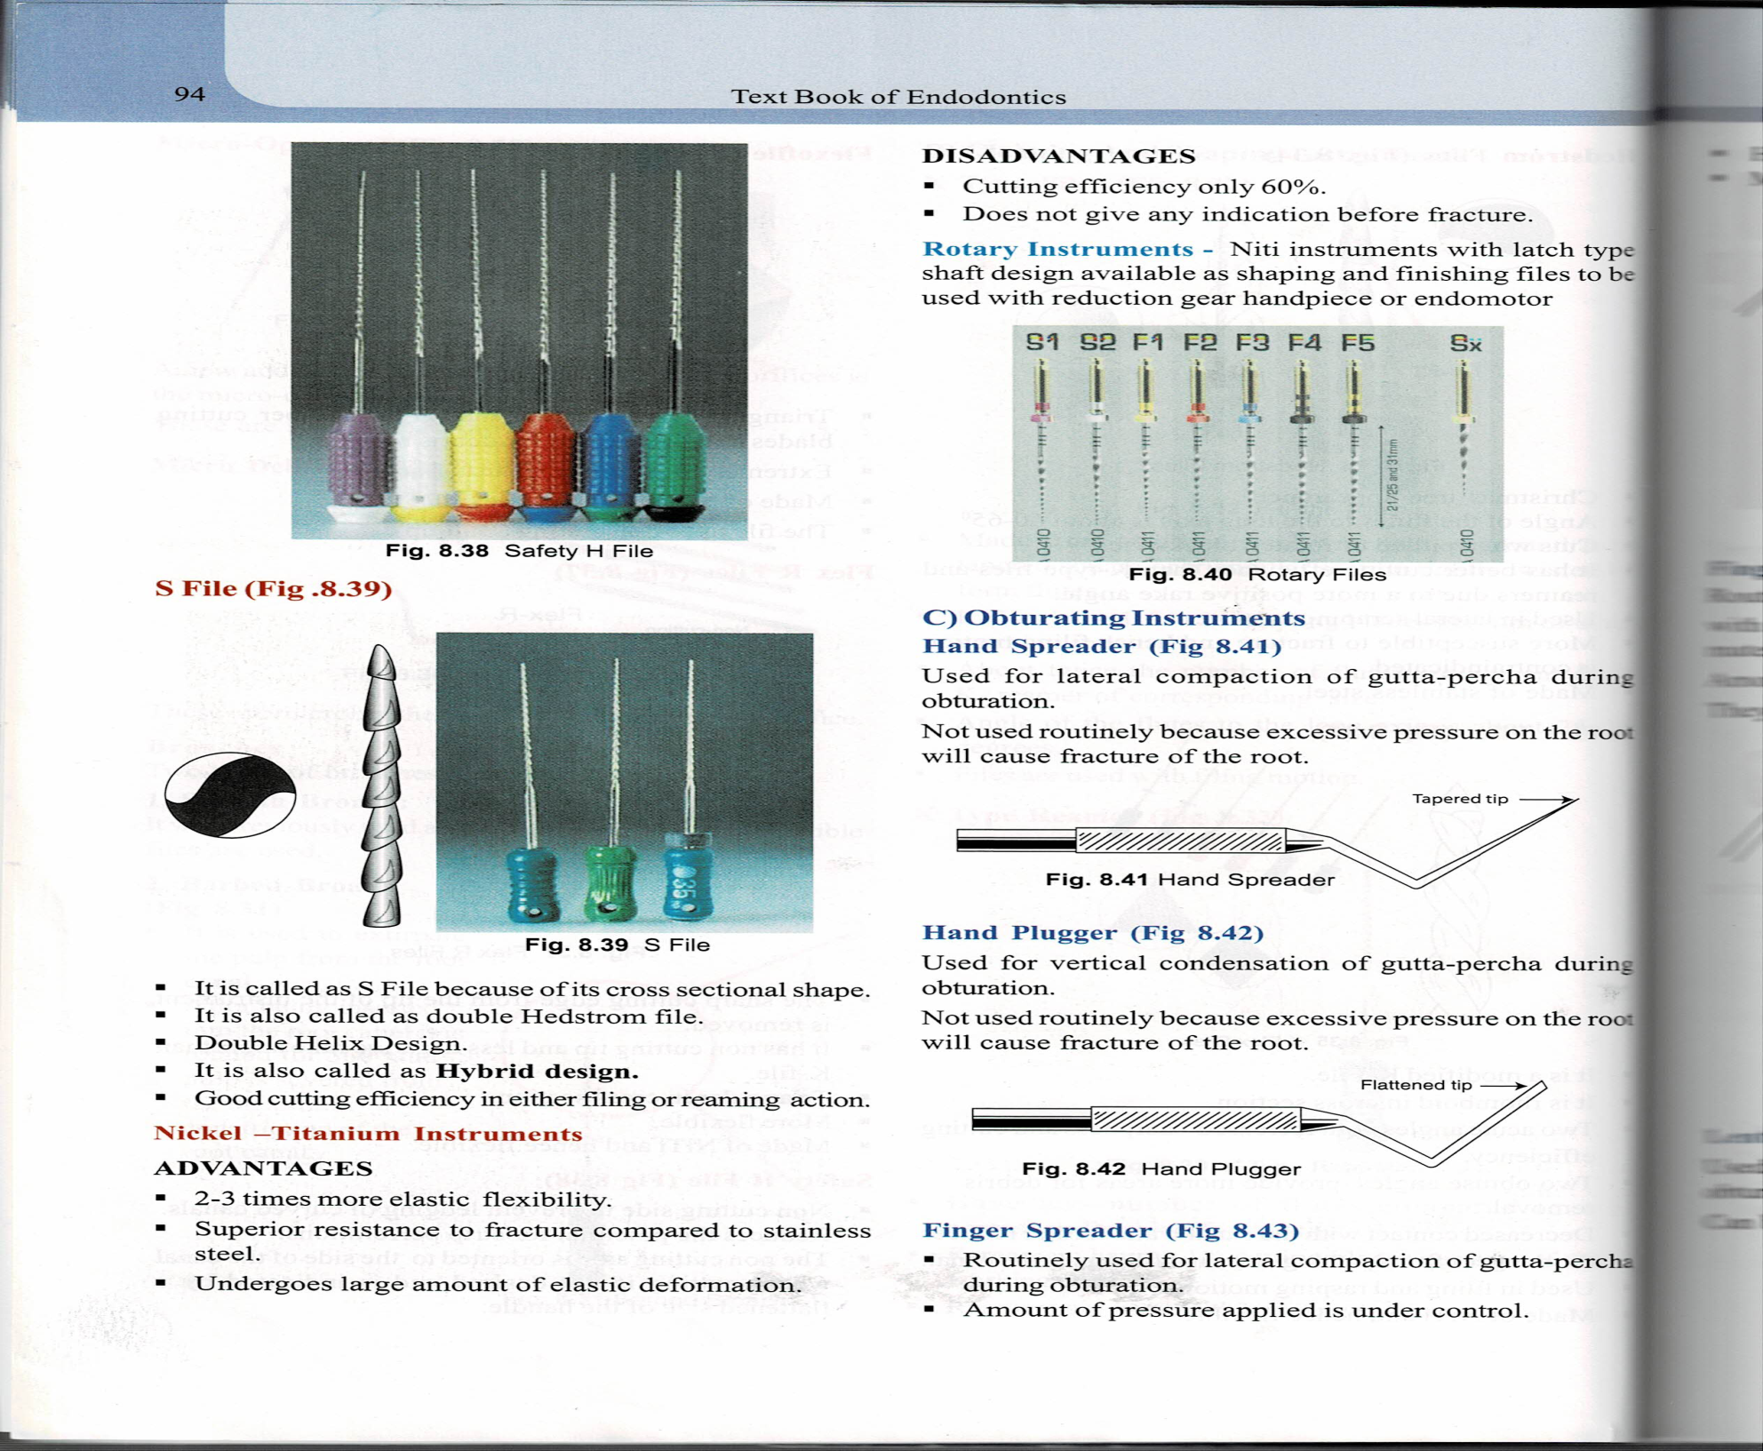
Flex R files
Sharp cutting edge of the instrument is removed
Non cutting tip & less negative rake angle than K-file
Triangular in cross section
More flexible
Made – NiTi – flexible
Safety H file
Non cutting side to prevent ledging of curved canals
Reduces the potential for strip perforations
The non cutting side is oriented to the side of the canal where cutting is not desired & is indicated by a flattened size of the handle

Slide 45

S FILE
Because of its cross sectional shape – called as S file
Also called as double Hedstrom file
Double helix design
Also called as hybrid design
Good cutting efficiency in either filing / reaming action

Slide 46
Nickel – titanium instruments
ADVANTAGES
DISADVANTAGES
2-3 times more elastic flexibility
Superior resistance to fracture compared to stainless steel
Undergoes large amount of elastic deformation
Cutting efficiency only 60%
Does not give any indication before fracture
ROTARY INSTRUMENTS
NiTi instruments with latch type shaft design available as shaping & finishing files to be used with reduction gear hand piece / endomotor

Slide 47


C. OBTURATING INSTRUMENTS
HAND SPREADER
Lateral compaction of GP
Excessive pressure on the root will cause fracture of the root
HAND PLUGGER
Vertical condensation of GP
Excessive pressure on the root will cause fracture of the root

Slide 48
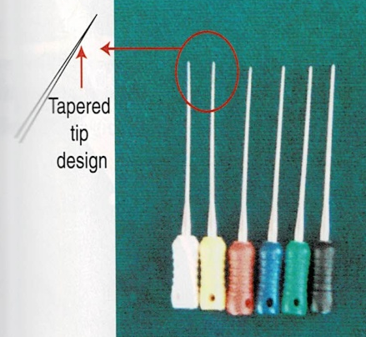


FINGER SPREADER
Lateral compaction of GP
Has better tactile sensitivity than hand spreaders
Made- stainless steel
FINGER PLUGGER
Vertical condensation of gp
More tactile sensitivity than hand plugger
LENTULOSPIRAL
Apply sealer cement to the root cnal walls before obturation
Can be used as hand / rotary instruments

Slide 49
ROTARY INSTRUMENTS

Slide 50
Disadvantages
Advantages
Easy to use
Saves time
Reduction in fatigue
Reduction in treatment time
Transportation, ledging & perforations
Hand instrumentation necessary
Loss of tactile sense
Apical packing of debris
Maintenance

Slide 51
HANDPIECES
CLASSIFICATION
Full rotary– latch/friction grip
Reciprocating/Quarter turn
Vertical
Ultrasonic and Sonic
Rotary
Reciprocal
Vertical
Random
Sonic
Ultrasonic
Ingle
Stock

Slide 52
Rotary handpieces
Straight line drilling/ side cutting
SS instruments used in straight canals
To develop coronal access
Widen the coronal two thirds of canal
Prepare post space channels
USES

Slide 53
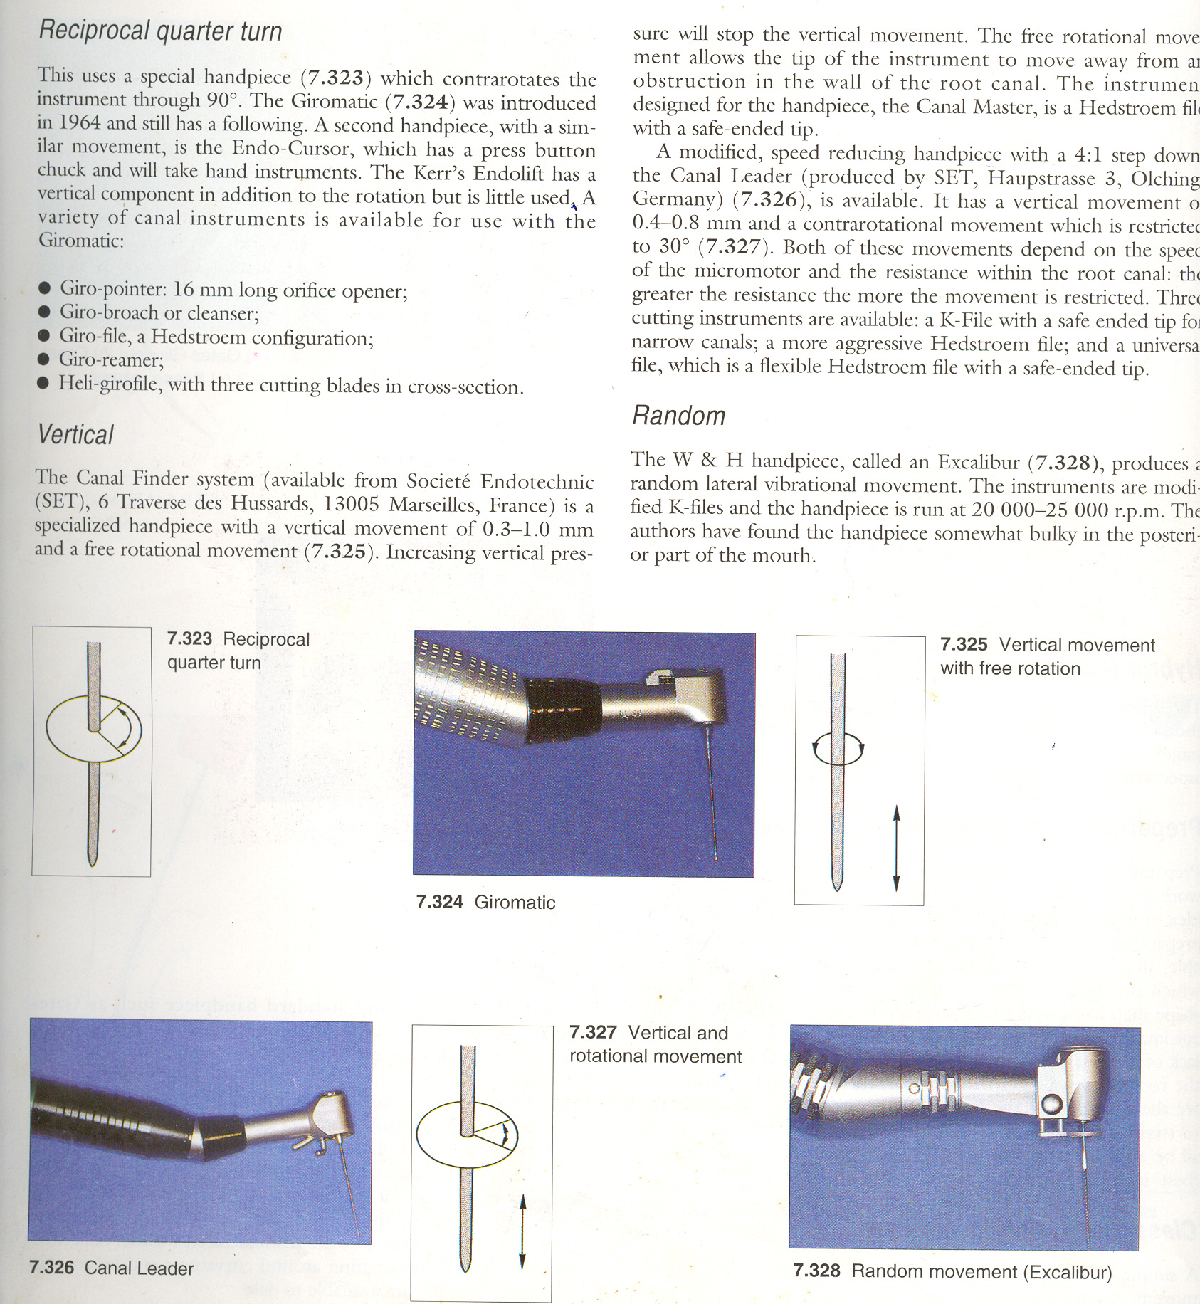
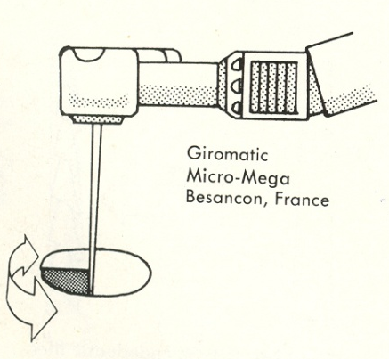
GIROMATIC -RECIPROCATING
Introduced in 1964 it was the first of the mechanized hand pieces
Accepts only latch type instruments
  Giro-broach or Giro-cleanser (latch type broaches)
  Giro-files (latch type Hedstroem files)
  Giro- reamer (latch type K style reamers)
  Heli-girofiles (latch type Helifile)
Uses a quarter turn (90⁰) reciprocating motion
Speed – 3000 rpm
The motion resembles he motion of the steering of the ship & hence called Giromatic

Slide 54
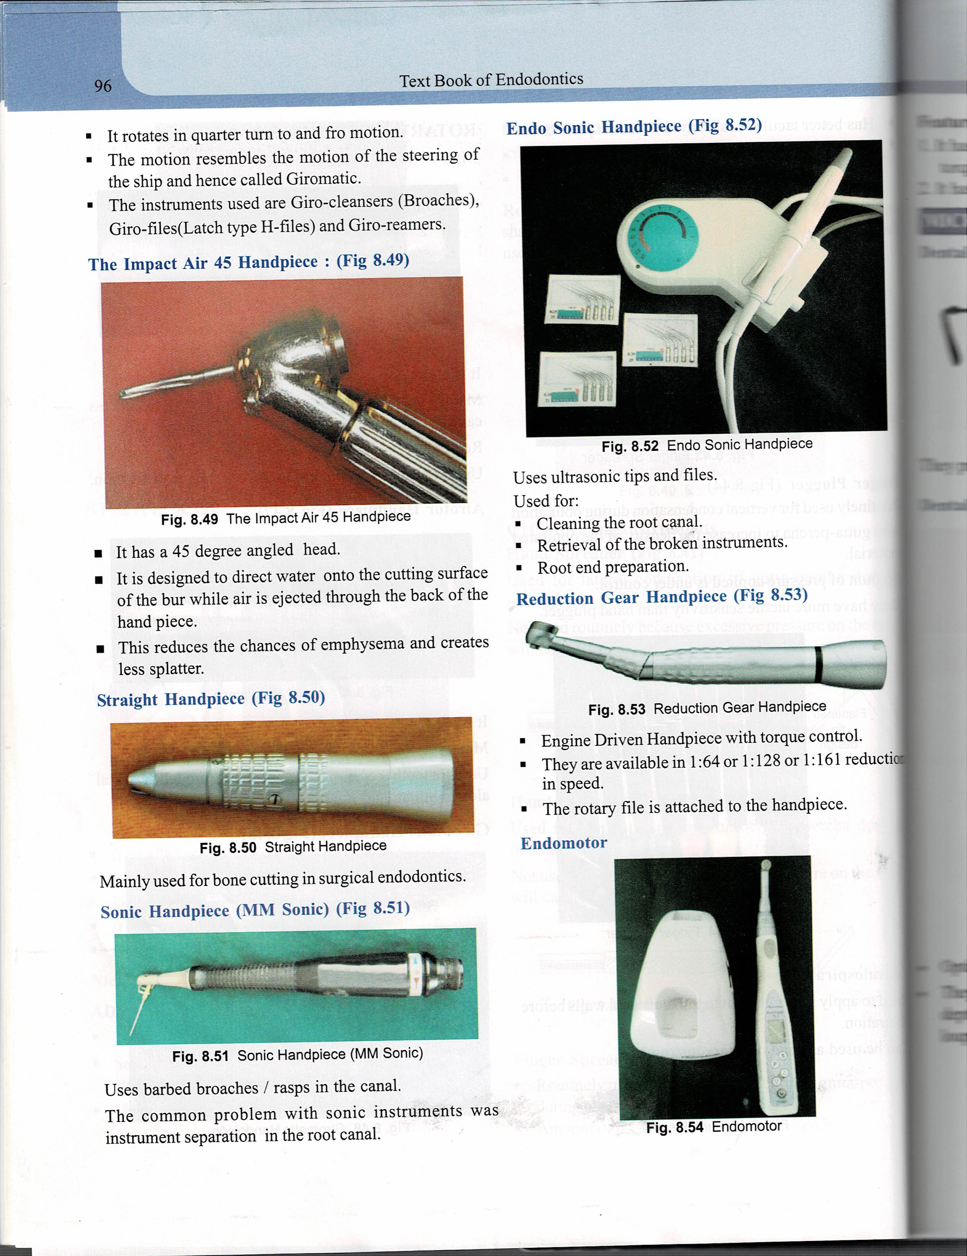

The impact air 45 handpiece
45 degree angled head
Designed to direct water onto the cutting surface of the bur while air is ejected through the back of the hand piece
This reduces the chances of emphysema & creates less splatter
Sonic hand piece (MM Sonic)
Uses – barbed broaches / rasps in the canal
Dis advantage – instrument separation in the canal

Slide 55

Endo sonic handpiece
Uses ultrasonic tips and files
Used – cleaning the root canal
- Instrument retrieval - broken instrument
-Root end preparations
Reduction gear handpiece
Engine driven hand piece with torque control
Available in 1: 64 / 1: 128 / 1:161 reduction in speed
Rotary files is attached to the handpiece
Endomotor
Has a large LCD display speed & torque
Has auto reverse & alarm function

Slide 56
